Slide 1
Strategic Racial Equity Action Plan (SREAP) Status Update September 2021

Slide 2
SREAP Purpose
To help us measure and significantly improve our results with culturally diverse workforce, businesses, representation and programming through:
Establishing a work plan and related budget to support the SREAP
Staff diversity and cultural competency development
Council and commission cultural competency development and responsiveness
Reflection of Roseville’s diversity in all marketing/branding

Slide 3
Equity Plan Development
Follows first SREAP created through GARE participation
Priority Areas: 1) Diversity in hiring and recruitment; 2) Board and commission diversity; 3) Using an equity lens in decision making
Staff throughout the organization will continue to implement and achieve their existing DEI initiatives which are not included in the ESAP work plan. However, staff should make sure they are able to complete the ESAP goals with excellence.
The community will see impact on their lives as the government implements the third Strategic Improvement (equity lens). For instance, as the City makes decisions with equity in mind, community members should see …
Main Audience: Intended to guide senior leaders and staff
Community stakeholders will be engaged and consulted as needed throughout equity and inclusion efforts

Slide 4
Current Status
Data Collection – Due Q3
Data has been collected and a workforce profile draft has been created from available Neogov data; HR working to identify and fill gaps as possible
Demographic survey was sent to current commissioners; applications on the city website have been updated to include demographic questions
Mapping of Current Customer Centered Processes – Due Q3
Department heads and staff from across the city participated in a series of process mapping workshops identifying current processes, challenges, opportunities, and feedback on ways to improve

Slide 5
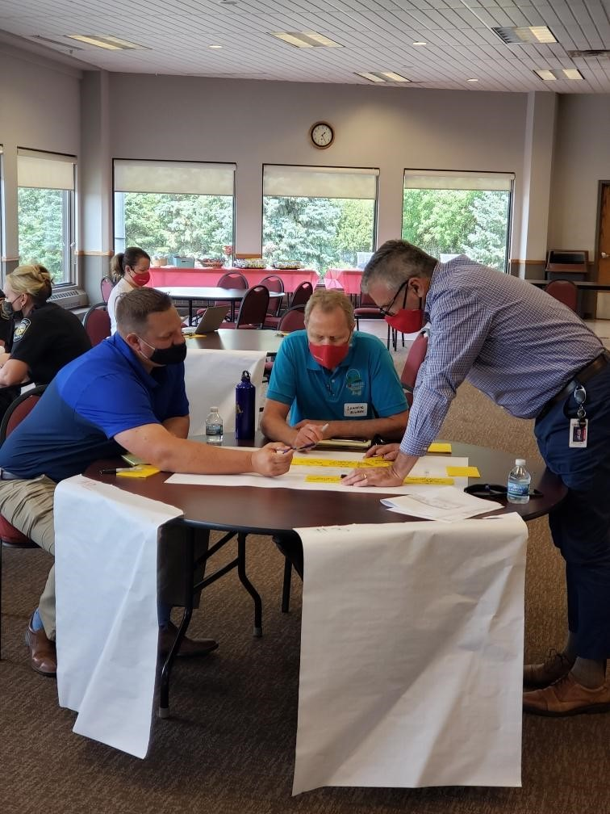
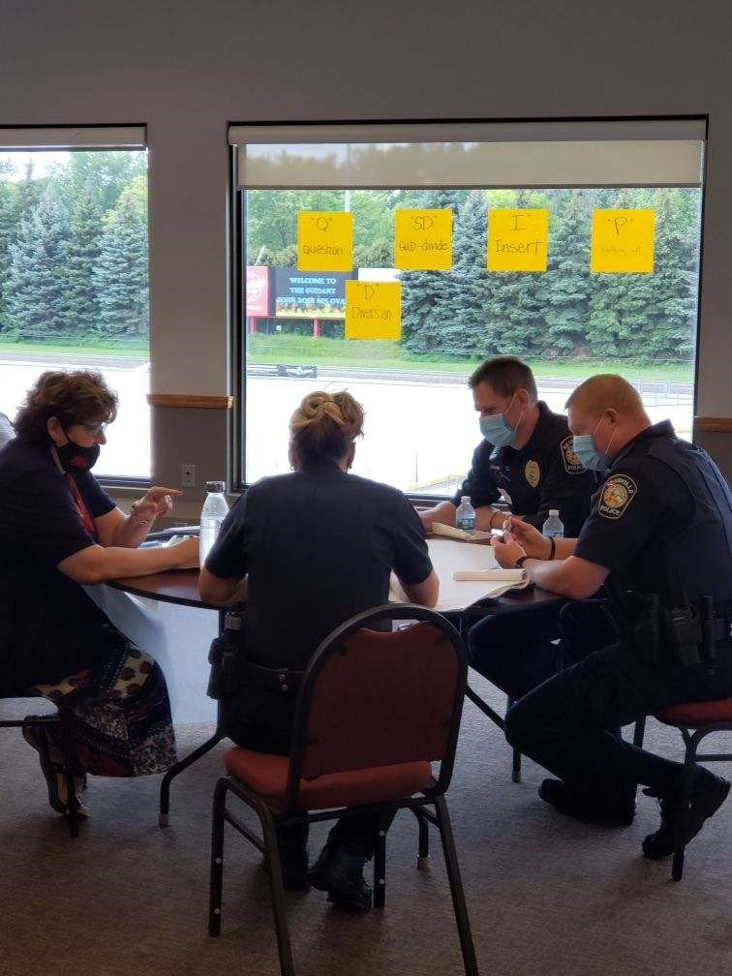
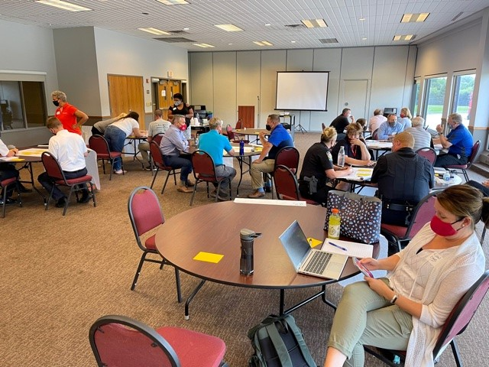
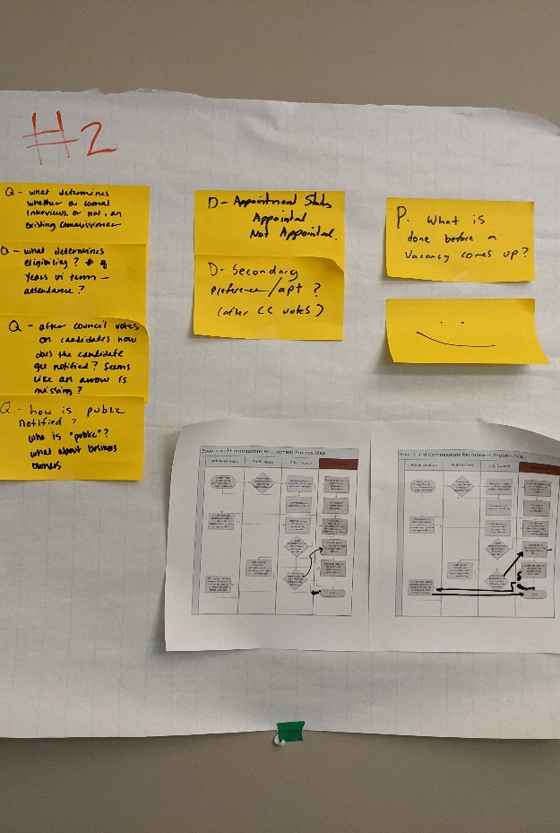
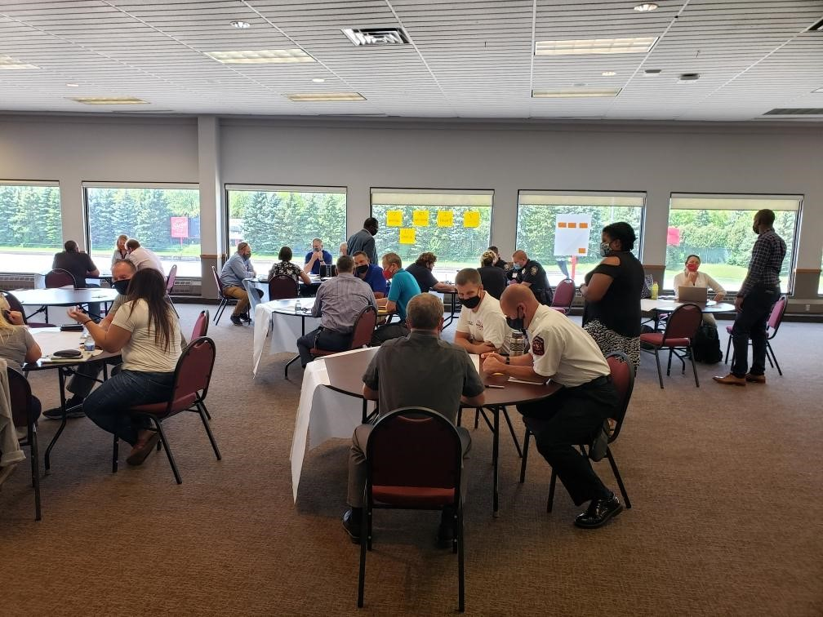
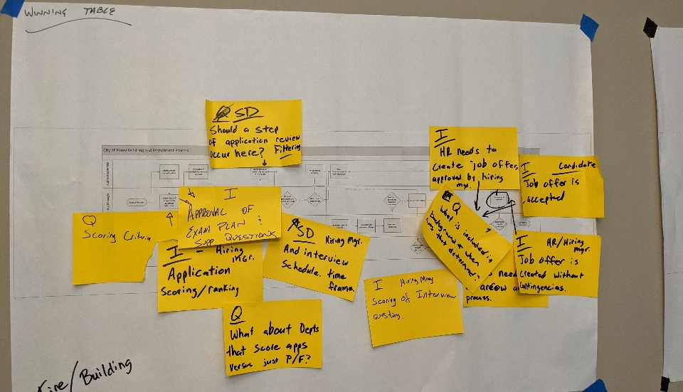
Process Mapping Workshops

Slide 6
Work in Progress
Data Analysis – Due Q4
Three workgroups of staff across departments have been formed to work through data analysis and to begin conversations on potential improvements
Data includes feedback from staff in workshops, Neogov hiring data, and demographic survey data for commissioners
Identify Improvements Using Data and VOC – Due Q1, 2022
Using available data and identified disparities, staff will work through identifying new processes; additional resources may include staff and community stakeholder (i.e. HRIEC) feedback; improvements made in other cities; LWV research; research on best practices

Slide 7
All Staff Communications
A presentation was developed to communicate SREAP priorities to all staff
Almost all departments have participated
Facilitated by Thomas, Rebecca, and Pat
Staff were able to ask questions and provide feedback
Will continue to find ways to keep staff informed and engaged through engagement opportunities, Intranet updates, Strategy Team members, Department Heads, and city communications

Slide 8
Next Steps
Council:
Provide feedback on Action Plan progress
Strategy Team and Staff:
Data analysis on decision points
Begin conversations on process improvement
Community
Engage in providing feedback on past experience in recruitment for boards, commissions, or employment

Slide 9
Questions?

